Slide 1
C# Language Basic
Continous staff improvement
Sergiu Grajdean

Slide 2
OBjectives
First program in C#
Type Basic
Predefined Types
Value Types Versus Reference Types
Value types
Reference types
The stack and heap
Boxing and unboxing
Parameter modifiers
by value
ref
out
Static members

Slide 3
First program in C#
Each program has an Entry Point
Each program consists of statements
First Hello World C# program
using System;
namespace L2Basic
{
class Program
{
static void Main(string[] args)
{
int result = 2*2;
Console.WriteLine(result); // prints 4 to output
Console.WriteLine("Hello World C#");
}
}
}

Slide 4
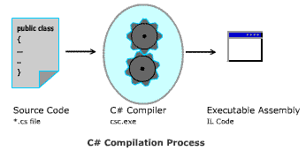
Compilation
The C# compiler compiles source code, specified as a set of files with the .cs extension, into an assembly
An assembly can be either an application or a library
A normal console or Windows application has a Main method and is an .exe file
A library is a .dll and is equivalent to an .exe without an entry point

Slide 5
Type Basic
A type defines the blueprint for a value
All values in C# are instances of a type
Predefined type examples: short, int, long, float, double, decimal, bool, char, string, object, etc.
Complex types can be built from primitive types
Class and Struct are basic units to build custom types
struct Point
{
public int X;
public int Y;
}

Slide 6
Value Types Versus Reference Types
All C# types fall into the following categories
Value types
Reference types
Generic type parameters
Pointer types
Value types comprise most built-in types (specifically, all numeric types, the char type, and the bool type) as well as custom struct and enum types
Reference types comprise all class, array, delegate, and interface types
The fundamental difference between value types and reference types is how they are handled in memory

Slide 7
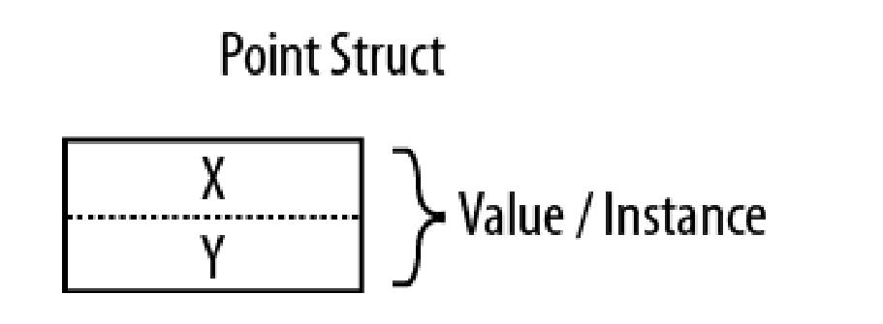
Value types
Variables that are based on value types directly contain values
Assigning one value type variable to another copies the contained value
All value types are derived implicitly from the System.ValueType
A value type cannot contain the null value
struct Point
{
public int X;
public int Y;
}

Slide 8
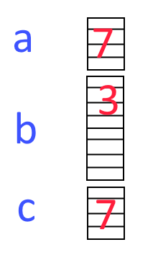
Value types
int a = 7; // allocate 4 bytes of memory for "a", store 7
long b = 3; // allocate 8 bytes of memory for "b", store 3
int c = a; // allocate 4 bytes for "c" and copy value "7"
c = 10; // set "c" to 10, a is still equals to "7"
a = 5; // set "a" to "5", "c" is equals "10"

Slide 9

Value types
Point p1 = new Point();
p1.X = 3;
p1.Y = 9;
Point p2 = p1;
p2.X = 5;

Slide 10
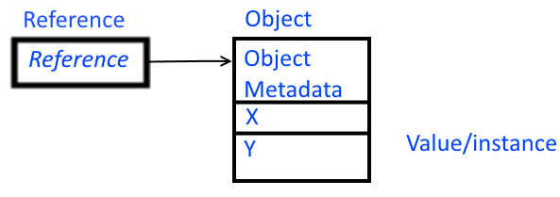
Reference types
Variables that are based on reference types store references to their data (objects)
Assigning one reference type variable to another copies the reference to instance (not the value itself)
All reference types are derived from the System.Object or its descendants
A reference type can store the null value
class Point
{
public int X;
public int Y;
}

Slide 11
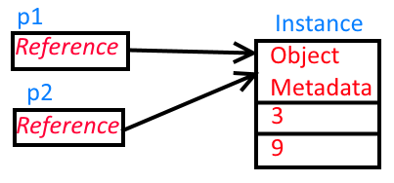
Reference types
Point p1 = new Point(); // p1 points to {X=0, Y=0}
p1.X = 3; // p1 points to {X=1, Y=0}
p1.Y = 9; // p1 points to {X=1, Y=9}
Point p2 = p1; // p1 and p2 points to {X=1, Y=9}
p2.X = 5; // p1 and p2 points to {X=5, Y=9}

Slide 12
Null
A reference can be assigned the literal null, indicating that the reference points to no object
A value type cannot ordinarily have a null value
class Point
{
public int X;
public int Y;
}
// More code....
Point p = null;
Console.WriteLine(p == null);

Slide 13
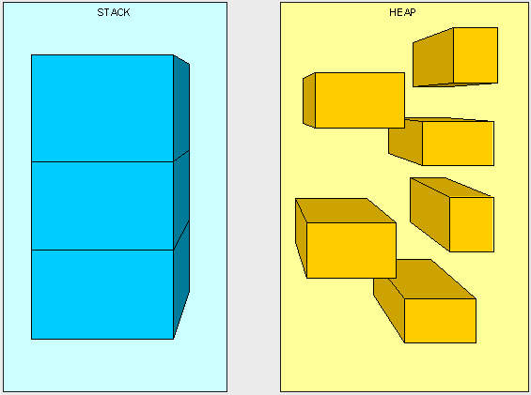
The stack and heap
The stack and the heap are the places where variables and constants reside

Slide 14
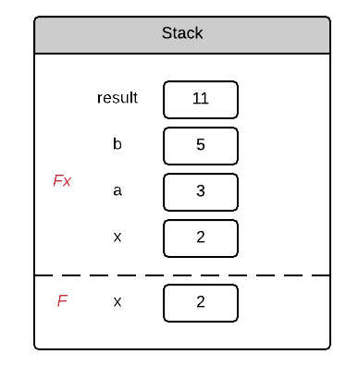
Stack
The stack is a block of memory for storing local variables and parameter
The Stack is self-maintaining, meaning that it basically takes care of its own memory management
void F()
{
Fx(2);
}
void Fx(double x)
{
double a = 3;
double b = 5;
double result = a*x + b;
}

Slide 15
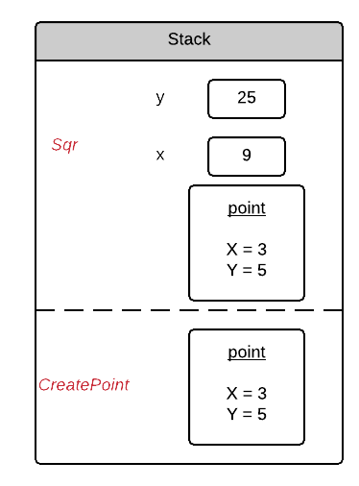
Stack
Struct example
struct Point{
public int X;
public int Y;
}
void CreatePoint(){
Point point =newPoint(){X = 3,Y=5};
Sqr(point);
}
void Sqr(Point point){
int x = point.X*point.X;
int y = point.Y*point.Y;
point.X = x;
point.Y = y;
}

Slide 16
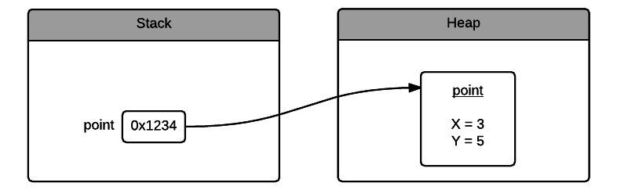
Heap
The heap is a block of memory in which objects (i.e., reference-type instances) reside
The runtime has a garbage collector that periodically deallocates objects from the heap

Slide 17
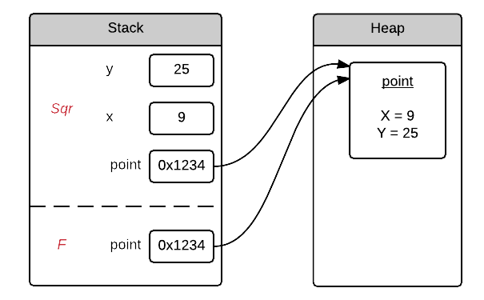

Heap
class Point{
public int X;
public int Y;
}
void CreatePoint(){
Pointpoint=newPoint()
{X=3,Y=5};
Sqr(point);
}
void Sqr(Point point)
{
intx=point.X*point.X;
inty=point.Y*point.Y;
point.X = x;
point.Y = y;
}

Slide 18
Boxing and unboxing
Boxing is the act of converting a value-type instance to a reference-type instance
Unboxing reverses the operation, by casting the object back to the original value type
Boxing copies the value-type instance into the new object, and unboxing copies the contents of the object back into a value-type instance
Boxing Example
Unboxing Example
int x = 9;
object obj = x; // Box the int
int y = (int)obj; // Unbox the int

Slide 19
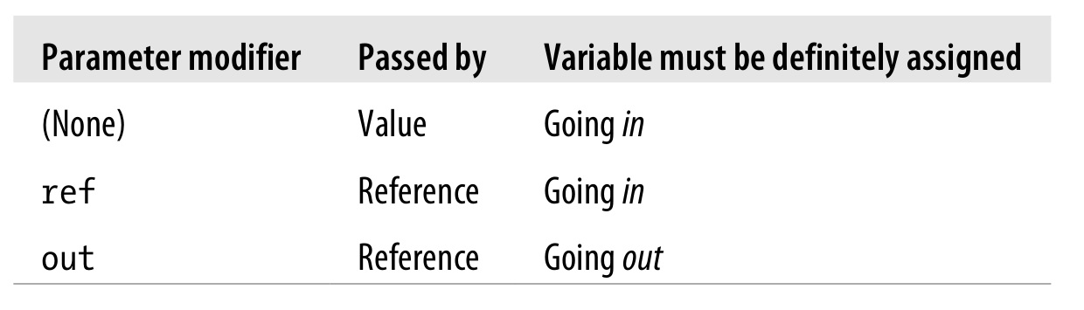
Parameter modifiers
Parameters define the set of arguments that must be provided for that method
By default, arguments in C# are passed by value
To pass by reference, C# provides the ref parameter modifier
An out argument is like a ref argument, except it
Need not be assigned before going into the function
Must be assigned before it comes out of the function

Slide 20
Passing arguments by value
static void Main()
{
int a = 1;
Point point = new Point{X = 3, Y = 5};
PassByValue(a,point); // make a copy of "a" and "point"
Console.WriteLine(a); // a = 1
Console.WriteLine(point.X + " " + point.Y); //point = {X=3, Y=5}
}
static void PassByValue(int a, Point point)
{
a = a +1; // change local variable
point = new Point(); // change copy of reference
}

Slide 21
The ref modifier
A parameter can be passed by reference or by value, regardless of whether the parameter type is a reference type or a value type.
static void Main()
{
int a = 1;
Point point = new Point { X = 3, Y = 5 };
PassByValue(ref a, ref point); // ask "PassByValue" to deal directly with "a" and "point"
Console.WriteLine(a); // a = 2
Console.WriteLine(point.X + " " + point.Y); //point = {X=0, Y=0}
}
static void PassByValue(ref int a, ref Point point)
{
a = a + 1; // increment "a"
point = new Point(); // set "point" to another instance
}

Slide 22
The out modifier
static void Main2()
{
int a;
Point point;
PassByValue(out a, out point); //
Console.WriteLine(a); // a = 1
Console.WriteLine(point.X + " " + point.Y); //point = {X=0, Y=0}
}
static void PassByValue(out int a, out Point point)
{
a = 1; // increment "a", a=a+1 - compile time error
point = new Point(); // set "point" to instance
}

Slide 23
Static members
A non-static class can contain static methods, fields, properties, or events.
The static member is callable on a class even when no instance of the class has been created.
The static member is always accessed by the class name, not the instance name.
Only one copy of a static member exists, regardless of how many instances of the class are created.
Static methods and properties cannot access non-static fields and events in their containing type, and they cannot access an instance variable of any object unless it is explicitly passed in a method parameter.

Slide 24
Static members
Static members example
public class Program
{
private static int x = 2;
static void Main(string[] args)
{
x = 5;
Console.WriteLine("Hello World C#");
Foo(); // compile time error
}
void Foo(){}
}

Slide 25
Assignment
Create a helLo world program in C#
Create instances of value types and reference types
Use static methods
Write a method for each type of parameter modifier
Use boxing and unboxing to prove the understanding of it
+Static constructor
+Threads

Slide 26
References
Albahari J, Albahari B (2012). C# 5.0 in a Nutshell.
MSDN
Matthew Cochran, C# Heap(ing) Vs Stack(ing) in .NET: Part I

Slide 27
Revisions
Number | Author | Date | Description
1.0.0 | Serghei Grajdean | 07.12.2015 | Initial version
1.0.1 | Serghei Grajdean | 11.02.2016 | Minor changes
1.0.2 | Mîțu Octavian | 02.20.2022 | Minor changes

